Slide 1

Angmagssallik Array 5 minute highlight
Stephen Dye - Cefas Marine Climate Change Centre (MC³)
stephen.dye@cefas.co.uk
@stephendye
Angmagssallik for OceanSites

Slide 2
Sustained Observations
at the Angmagsallik Array ended in Summer 2015

Slide 3
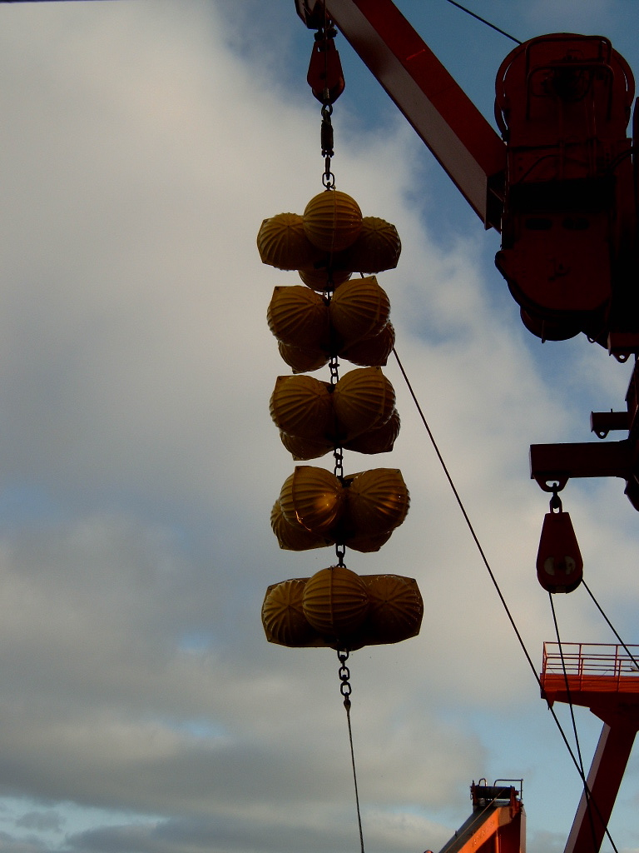
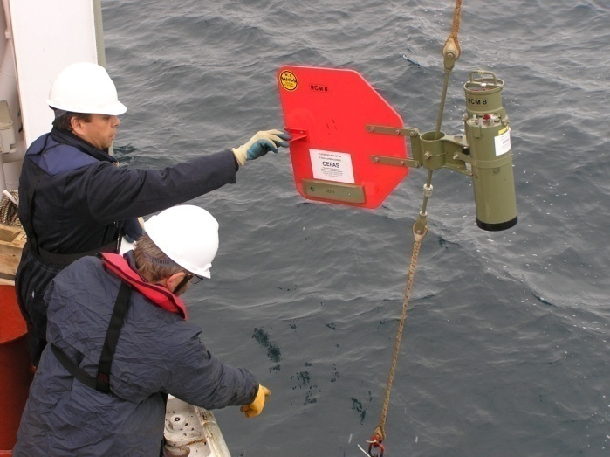
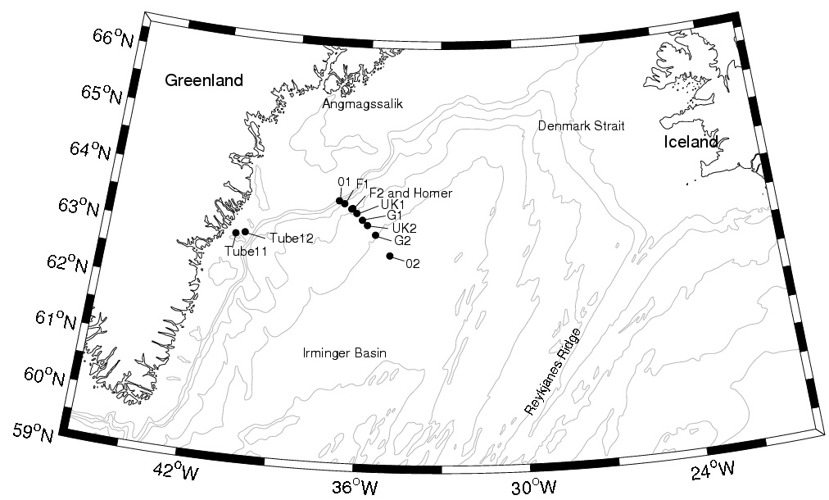
We measured Denmark Strait overflow from 1986 until the final recovery 2015, in collaboration with IFM -UHAM & FIMR.
Overflow: Angmagssalik Array

Slide 4
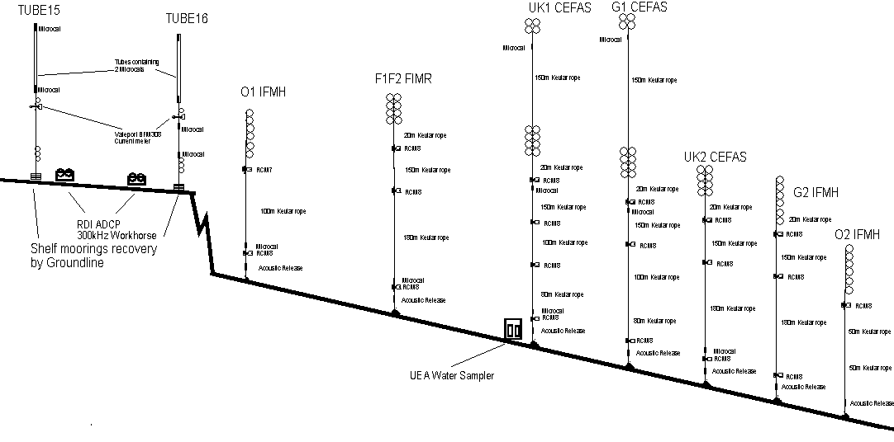
Final 2 moorings deployment in 2012 in red boxes
Bottom 300m in the overflow plume
The Angmagssalik Array

Slide 5
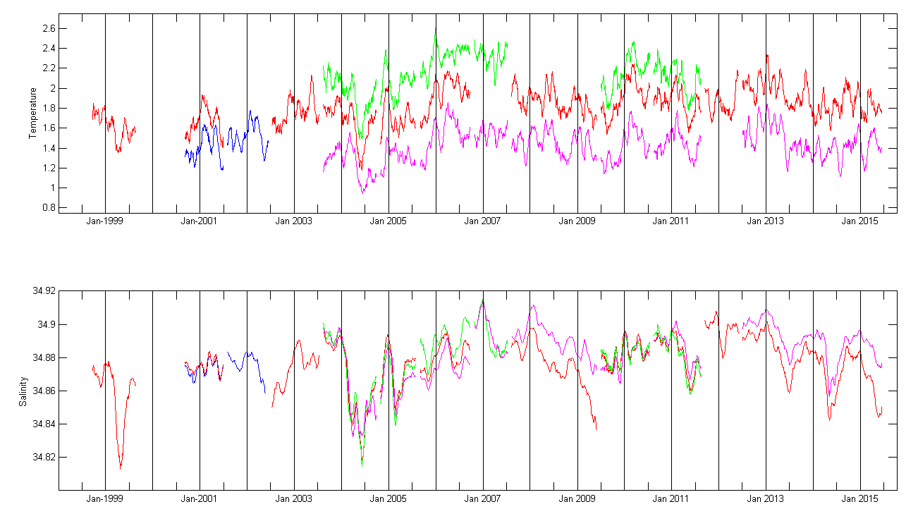
Final deployment 3 years
Microcats – 3 years data returned
Current meters -<18 months data returned.
Means we have
Current meters 1986-2013
Microcats 1998-2015
Regular spring freshening of the overflow plume
10 of 16 years. Not always compensated in T. Seasonal switching of sources??
Provisional microcat data (28day box mean)
UK1
UK2
PhD student starting at BAS in September – investigate overflow formation mechanisms & ‘spilljet’
Timeseries of Denmark Strait Overflow

Slide 6
Huge Thank-You
Over the years too many to thank but for the final deployment and recovery:
Hamburg – Quadfasel, Welsch, Drubbisch, Jochumsen, Meteor Leitstelle
GEOMAR – Karstensen

